Slide 1
Network Topology
MD: Tawhid Khan
ID: 1205006
Round :28
Batch ID : ID-NT/ACSL-01M/R28/01

Slide 2
What Is Network Topology
In communication networks, a topology is a usually schematic description of the arrangement of a network, including its nodes and connecting lines. There are two ways of defining network geometry: the physical topology and the logical (or signal) topology.

Slide 3
Type Of Network Topology
Bus (Coxil cable)
Star (Hub/Switch)
Ring (Mau)
Mesh
Point to point
Point to multipoint
Hybrid Topology

Slide 4
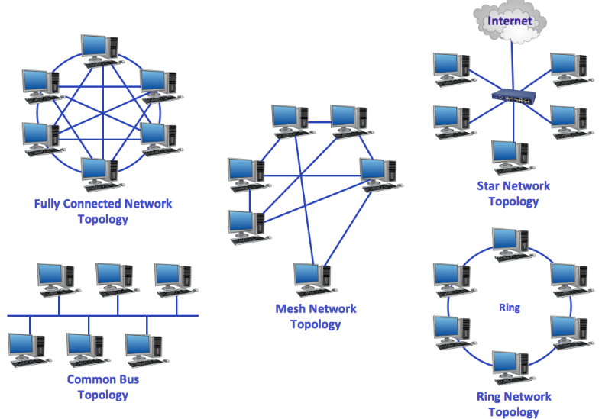
Network Topology

Slide 5
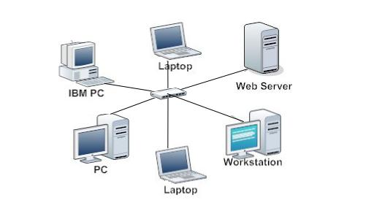
Star Topology
star topology is one of the most common network setups. In this configuration, every node connects to a central network device, like a hub, switch, or computer. The central network device acts as a server and the peripheral devices act as clients .

Slide 6
Advantages of star topology
Centralized management of the network, through the use of the central computer, hub, or switch.
Easy to add another computer to the network.
If one computer on the network fails, the rest of the network continues to function normally.

Slide 7
Disadvantages of star topology
1 .Can have a higher cost to implement, especially when using a switch or router as the central network device.
2 .The central network device determines the performance and number of nodes the network can handle.
3 .If the central computer, hub, or switch fails, the entire network goes down and all computers are disconnected from the network.

Slide 8
Thank you

